Slide 1


The Lean Startup
#leanstartup
Eric Ries (@ericries)
http://startuplessonslearned.blogspot.com

Slide 2
Thank You!
Scholarship Donors
  KISSmetrics
  Bill Braasch (@billmelater)
  Bob Aniello (@CornOnTheBob)
Customer Advisory Board
  Hiten Shah
  Jared Goralnick
  Siqi Chen
  Andrew Meyer
  Simon Newstead
  Jeffrey Barman
  Sean Heywood

Slide 3
Most Startups Fail
But it doesn’t have to be that way. We can do better. This talk is about how.
Notes:
Hi, I’m Eric Ries. I wan to talk to you today about one simple fact: that the vast majority of high-tech startups fail.
It does not have to be that way.
Read the stories of successful startups and, if the founders are willing to be honest, you will see this pattern over and over again. They started out as digital cash for PDAs, but evolved into online payments for eBay. They started building BASIC interpreters, but evolved into the world's largest operating systems monopoly. They were shocked to discover their online games company was actually a photo-sharing site.
Each of these companies were fortunate to have enough time, resources, and patience to endure the multiple iterations it took to find a successful product and market. The premise of the lean startup is simple: if we can reduce the time between these major iterations, we can increase the odds of success.

Slide 4
The Lean Startup and You
Thinking of starting a new company, but haven’t taken the first step
In a startup now and want to iterate faster
Want to create the conditions for lean innovation inside a big company
Notes:
… remember that a startup is not a shrunken-down big company.

Slide 5
A Tale of Two Startups

Slide 6
Startup #1

Slide 7
A good plan?
Start a company with a compelling long-term vision.
Raise plenty of capital.
Hire the absolute best and the brightest.
Hire an experienced management team with tons of startup experience.
Focus on quality.
Build a world-class technology platform.
Build buzz in the press and blogosphere.
Notes:
Start a company with a compelling long-term vision. Don't get distracted by trying to flip it. Instead, try and build a company that will matter on the scale of the next century. Aim to become the "next AOL or Microsoft" not a niche player.
Raise sufficient capital to have an extended runway from experienced smart money investors with deep pockets who are prepared to make follow-on investments.
Hire the absolute best and the brightest, true experts in their fields, who in turn can hire the smartest people possible to staff their departments. Insist on the incredibly high-IQ employees and hold them to incredibly high standards.
Bring in an expert CEO with outstanding business credentials and startup experience to focus on relentless execution.
Build a truly mainstream product. Focus on quality. Ship it when it's done, not a moment before. Insist on high levels of usability, UI design, and polish. Conduct constant focus groups and usability tests.
Build a world-class technology platform, with patent-pending algorithms and the ability to scale to millions of simultaneous users.
Launch with a PR blitz, including mentions in major mainstream publications. Build the product in stealth mode to build buzz for the eventual launch.

Slide 8
Achieving Failure
Company failed utterly, $40MM and five years of pain.
Crippled by “shadow beliefs” that destroyed the effort of all those smart people.

Slide 9
Shadow Belief #1
We know what customers want.
Notes:
By hiring experts, conducting lots of focus groups, and executing to a detailed plan, the company became deluded that it knew what customers wanted. I remember vividly a scene at a board meeting, where the company was celebrating a major milestone. The whole company and board play-tested the product to see its new features first hand. Everyone had fun; the product worked. But that was two full years before any customers were allowed to use it. Nobody even asked the question: why not ship this now? It was considered naive that the "next AOL" would ship a product that wasn't ready for prime time. Stealth is a customer-free zone. All of the efforts to create buzz, keep competitors in the dark, and launch with a bang had the direct effect of starving the company for much-needed feedback.

Slide 10
Shadow Belief #2
We can accurately predict the future.
Notes:
Even though some aspects of the product were eventually vindicated as good ones, the underlying architecture suffered from hard-to-change assumptions. After years of engineering effort, changing these assumptions was incredibly hard. Without conscious process design, product development teams turn lines of code written into momentum in a certain direction. Even a great architecture becomes inflexible. This is why agility is such a prized quality in product development.

Slide 11
Shadow Belief #3
Advancing the plan is progress.
Notes:
This is the most devastating thing about achieving a failure: while in the midst of it, you think you're making progress. This company had disciplined schedules, milestones, employee evaluations, and a culture of execution. When schedules were missed, people were held accountable. Unfortunately, there was no corresponding discipline of evaluating the quality of the plan itself. As the company built infrastructure and added features, the team celebrated these accomplishments. Departments were built and were even metrics-driven. But there was no feedback loop to help the company find the right metrics to focus on.

Slide 12
A good plan?
Start a company with a compelling long-term vision.
Raise plenty of capital.
Hire the absolute best and the brightest.
Hire an experienced management team with tons of startup experience.
Focus on quality.
Build a world-class technology platform.
Build buzz in the press and blogosphere.
Notes:
Do our actions live up to our ideals?

Slide 13
Startup #2

Slide 14

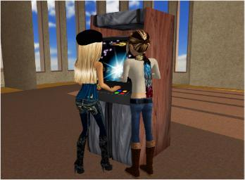







IMVU
Notes:
After our crushing failure, the founders of my next company decided to question every single assumption for how a startup should be built. Failure gave us the courage to try some radical things.

Slide 15
New plan
Shipped in six months – a horribly buggy beta product
Charged from day one
Shipped multiple times a day (by 2008, on average 50 times a day)
No PR, no launch
Results: 2007 revenues of $10MM

Slide 16
Lean Startups Go Faster
Commodity technology stack, highly leveraged (free/open source, user-generated content, SEM).
Customer development – find out what customers want before you build it.
Agile software development – but tuned to the startup condition.
Notes:
Based on that experience, and the experience of the other startups I have worked for, I now strongly believe there is a better way to create startups. I’ve called this vision the Lean Startup. It combines three key trends.

Slide 17
Commodity technology stack
Leverage = for each ounce of effort you invest in your product, you take advantage of the efforts of thousands or millions of others.
It’s easy to see how high-leverage technology is driving costs down.
More important is its impact on speed.
Time to bring a new product to market is falling rapidly.

Slide 18
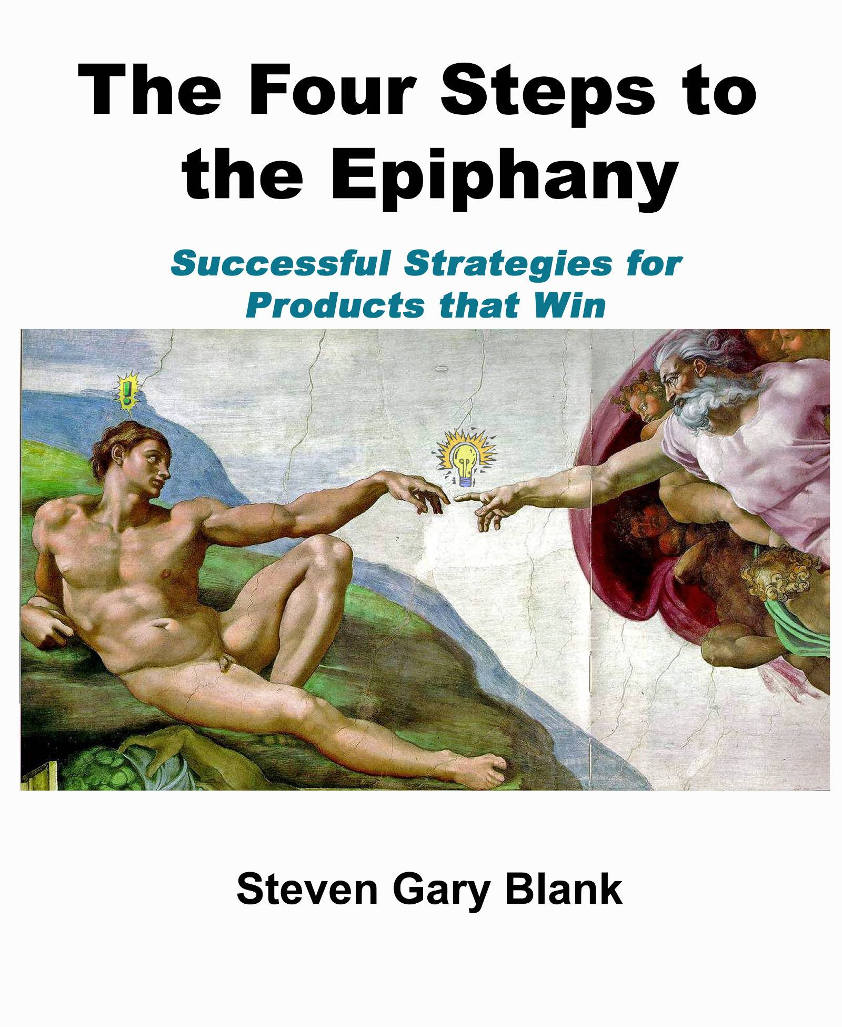
Customer Development
Continuous cycle of customer interaction
  Rapid hypothesis testing about market, pricing, customers, …
  Extreme low cost, low burn, tight focus
  Measurable gates for investors
http://bit.ly/tpTtE

Slide 19
A tale of two startups, revisited
Mirrors the changes in development methodologies over the past few years.
Let’s look at those changes schematically.
These examples are drawn from software startups, but increasingly:
  All products require software
  All companies are operating in a startup-like environment
Notes:
Ladder of inference

Slide 20
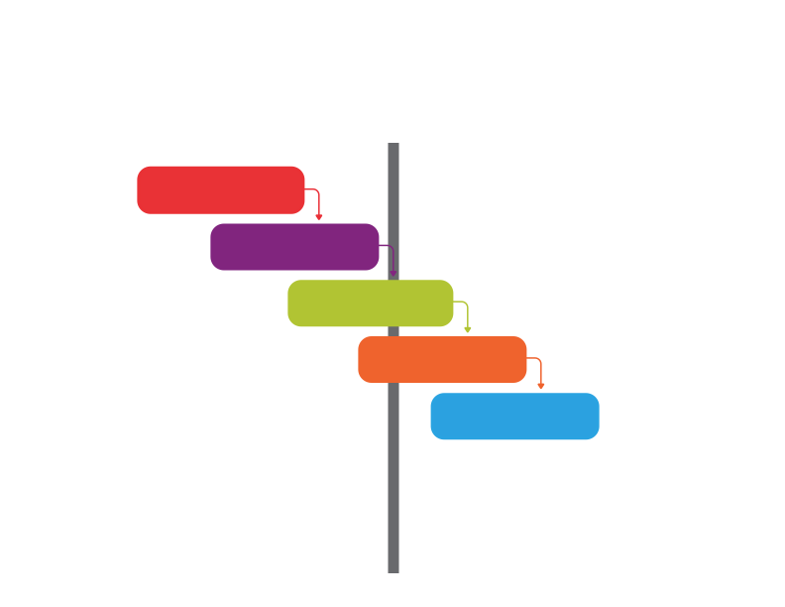
Traditional Product Development
Unit of progress: Advance to Next Stage
Waterfall
Requirements
Design
Problem: known
Solution: known
Implementation
Verification
Maintenance
Notes:
20

Slide 21
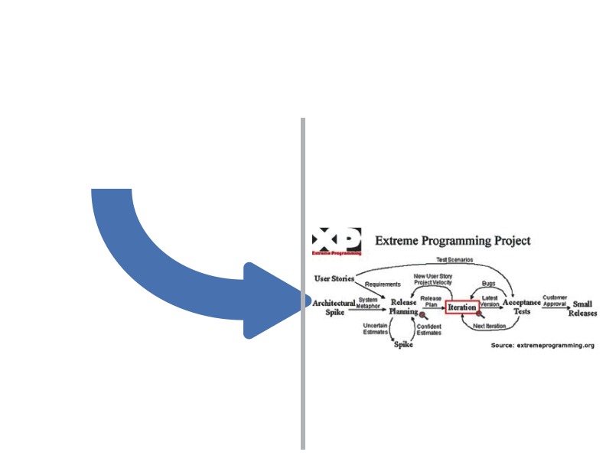
Agile
Unit of progress: a line of working code
“Product Owner” or
in-house customer
Problem: Known
Solution: Unknown
Notes:
21

Slide 22
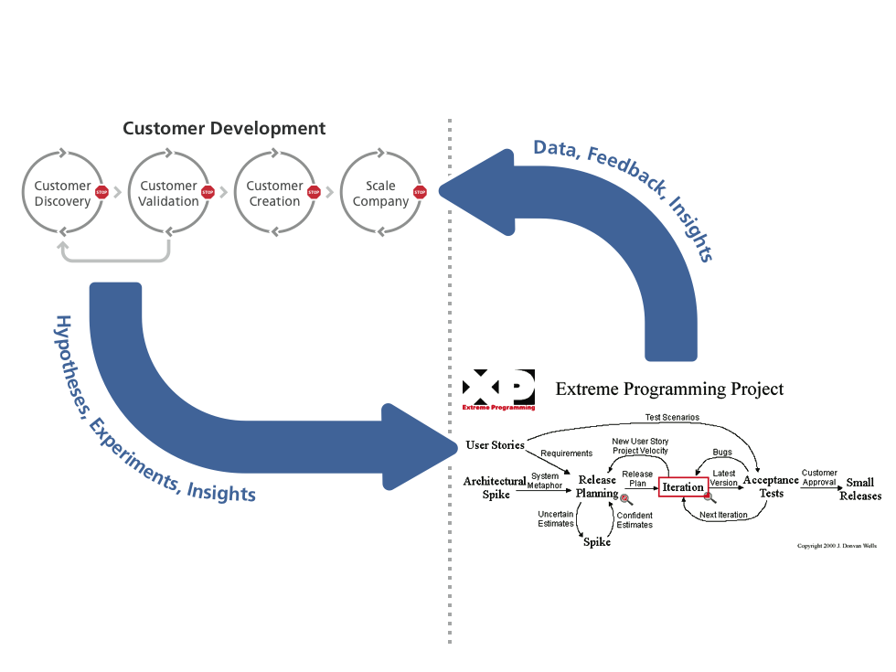
Product Development at Lean Startup
Unit of progress: validated learning about customers ($$$)
Problem: Unknown
Solution: Unknown
Notes:
IMVU started life as an “IM add-on” product.
It sounded like a brilliant strategy – on a whiteboard.

Slide 23
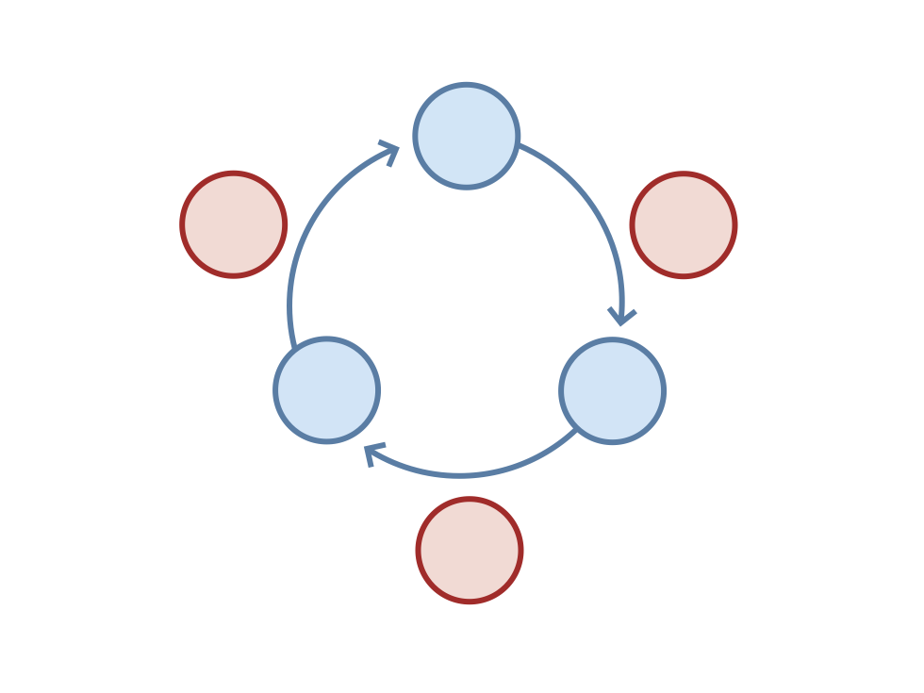
Minimize TOTAL time through the loop
IDEAS
LEARN
BUILD
DATA
CODE
MEASURE
Notes:
This is the core feedback loop that powers startups. Their goal is not to optimize the time it takes to do any one of these steps.
There are many specific practices that can power lean startups, and we’ll cover a few in this presentation. But more important than any specific practice is this core idea: startups should be built to learn.

Slide 24
How to build a Lean Startup
Let’s talk about some specifics. These are not everything you need, but they will get you started
Continuous deployment
Split-test (A/B) experimentation
Five why’s

Slide 25
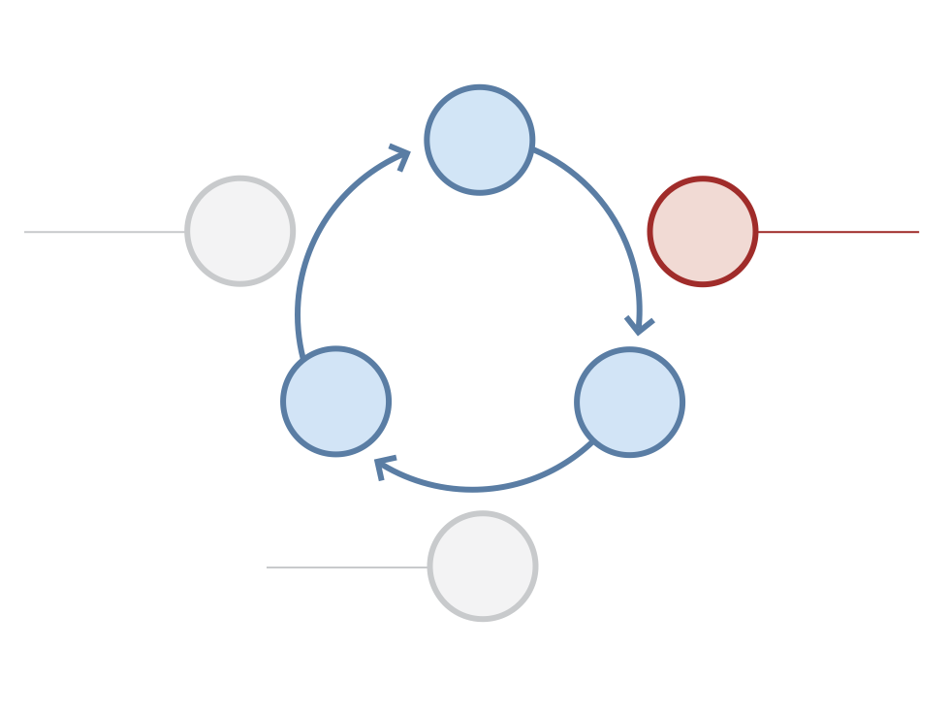
Continuous Deployment
IDEAS
Learn Faster
Code Faster
LEARN
BUILD
Five Whys Root
Cause Analysis
Continuous
Deployment
DATA
CODE
Measure Faster
MEASURE
Rapid Split Tests

Slide 26
Continuous Deployment
  Deploy new software quickly
    At IMVU time from check-in to production = 20 minutes
  Tell a good change from a bad change (quickly)
  Revert a bad change quickly
  Work in small batches
    At IMVU, a large batch = 3 days worth of work
  Break large projects down into small batches

Slide 27
Cluster Immune System
What it looks like to ship one piece of code to production:
  Run tests locally (SimpleTest, Selenium)
    Everyone has a complete sandbox
  Continuous Integration Server (BuildBot)
    All tests must pass or “shut down the line”
    Automatic feedback if the team is going too fast
  Incremental deploy
    Monitor cluster and business metrics in real-time
    Reject changes that move metrics out-of-bounds
  Alerting & Predictive monitoring (Nagios)
    Monitor all metrics that stakeholders care about
    If any metric goes out-of-bounds, wake somebody up
    Use historical trends to predict acceptable bounds
  When customers see a failure:
    Fix the problem for customers
    Improve your defenses at each level
Notes:
Run tests locally:
-- Sandbox includes as much of production as humanly possible (db, memcached, Solr, Apache).
-- Write tests in every language. We use 8 different test frameworks for different environs. Otherwise you get fear and brittle.
-- Example kind of problem is that AJAX updater for site header. Seemingly innocuous change would break shopping experience.
CIT/BuildBot:
-- Simply don’t push with red tests. Even if the site is in trouble. Example Christmas site outage with memcache sampling.
-- Give an idea of the scale. 20 machine cluster, runs 10000 tests and 100,000’s of thousand of assertions on every change.
Incremental deploy:
-- Catch performance bugs and gaps in test coverage
Slow query in free tags. This started to drive database load higher on one MySQL instance due to contention and data size. Detected and rolled back before it affected users and before the database was hosed due to high load.
Changed transaction commit logic in foundation of the system. This passed all tests but caused registrations to fail in production due to subtle difference between sandbox and production. System detected drop in business metric in 1 minute and reverted the change
Alerting and Predictive Monitoring
Example: Second tier ISP to block our outbound email
Example: Rooms list performance time bomb
Example: Registration quality, second tier payment methods, invite mail success rates by service
Story: Anything that can go wrong will, so just catch it then fast.

Slide 28
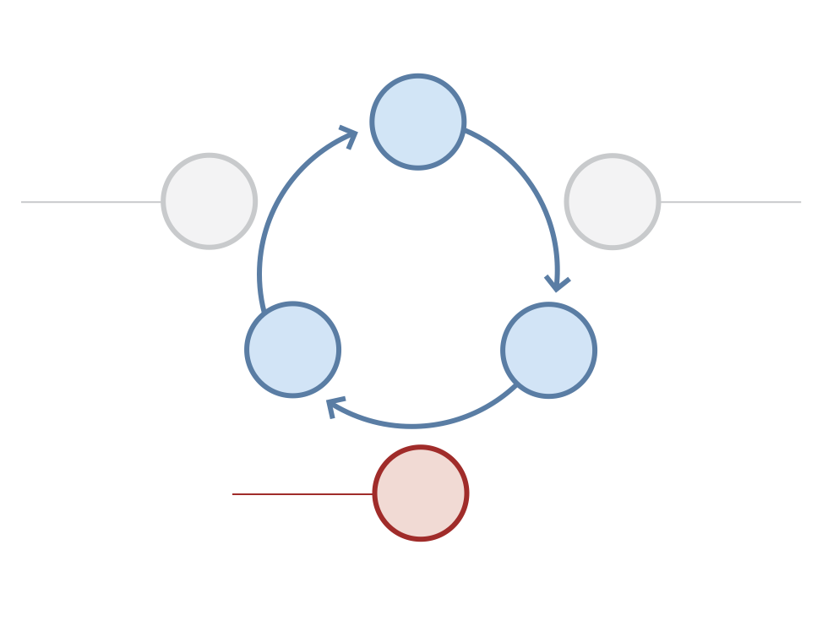
Rapid Split Tests
IDEAS
Learn Faster
Code Faster
LEARN
BUILD
Five Whys Root
Cause Analysis
Continuous
Deployment
DATA
CODE
Measure Faster
MEASURE
Rapid Split Tests

Slide 29
Split-testing all the time
A/B testing is key to validating your hypotheses
Has to be simple enough for everyone to use and understand it
Make creating a split-test no more than one line of code:
if( setup_experiment(...) == "control" ) {
// do it the old way
} else {
// do it the new way
}

Slide 30
The AAA’s of Metrics
Actionable
Accessible
Auditable

Slide 31
Measure the Macro
Always look at cohort-based metrics over time
Split-test the small, measure the large
 | Control Group (A) | Experiment (B)
# Registered | 1025 | 1099
Downloads | 755 (73%) | 733 (67%)
Active days 0-1 | 600 (58%) | 650 (59%)
Active days 1-3 | 500 (48%) | 545 (49%)
Active days 3-10 | 300 (29%) | 330 (30%)
Active days 10-30 | 250 (24%) | 290 (26%)
Total Revenue | $3210.50 | $3450.10
RPU | $3.13 | $3.14

Slide 32
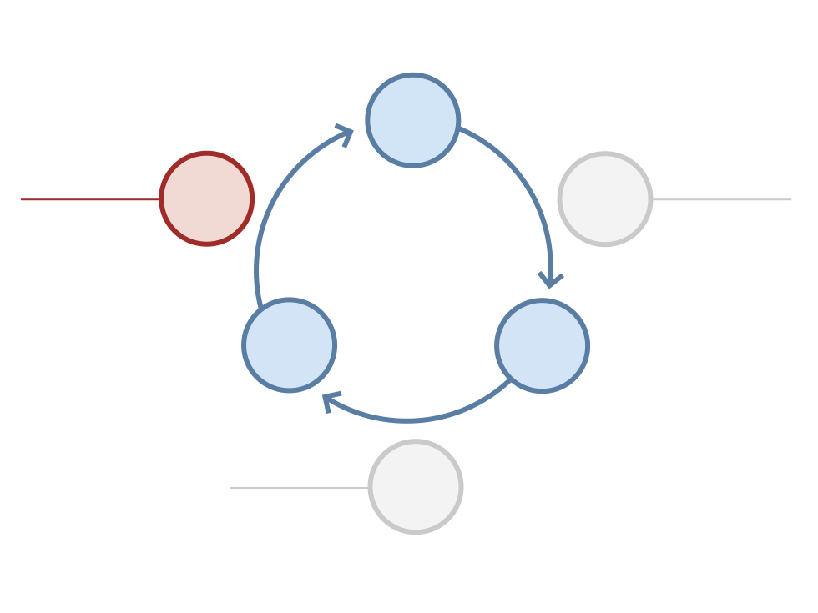
Five Whys
IDEAS
Learn Faster
Code Faster
LEARN
BUILD
Five Whys Root
Cause Analysis
Continuous
Deployment
DATA
CODE
Measure Faster
MEASURE
Rapid Split Tests

Slide 33
Five Whys Root Cause Analysis
A technique for continuous improvement of company process.
Ask “why” five times when something unexpected happens.
Make proportional investments in prevention at all five levels of the hierarchy.
Behind every supposed technical problem is usually a human problem. Fix the cause, not just the symptom.
Notes:
When something goes wrong, we tend to see it as a crisis and seek to blame. A better way is to see it as a learning opportunity. Not in the existential sense of general self-improvement. Instead, we can use the technique of asking why five times to get to the root cause of the problem.
Here's how it works. Let's say you notice that your website is down. Obviously, your first priority is to get it back up. But as soon as the crisis is past, you have the discipline to have a post-mortem in which you start asking why:
1. why was the website down? The CPU utilization on all our front-end servers went to 100%
2. why did the CPU usage spike? A new bit of code contained an infinite loop!
3. why did that code get written? So-and-so made a mistake
4. why did his mistake get checked in? He didn't write a unit test for the feature
5. why didn't he write a unit test? He's a new employee, and he was not properly trained in TDD
So far, this isn't much different from the kind of analysis any competent operations team would conduct for a site outage. The next step is this: you have to commit to make a proportional investment in corrective action at every level of the analysis. So, in the example above, we'd have to take five corrective actions:
1. bring the site back up
2. remove the bad code
3. help so-and-so understand why his code doesn't work as written
4. train so-and-so in the principles of TDD
5. change the new engineer orientation to include TDD

Slide 34

There’s much more…
IDEAS
Learn Faster
Code Faster
LEARN
BUILD
Split Tests
Customer Interviews
Customer Development
Five Whys Root Cause Analysis
Customer Advisory Board
Falsifiable Hypotheses
Product Owner Accountability
Customer Archetypes
Cross-functional Teams
Semi-autonomous Teams
Smoke Tests
Unit Tests
Usability Tests
Continuous Integration
Incremental Deployment
Free & Open-Source Components
Cloud Computing
Cluster Immune System
Just-in-time Scalability
Refactoring
Developer Sandbox
DATA
CODE
Measure Faster
MEASURE
Split Tests
Clear Product Owner
Continuous Deployment
Usability Tests
Real-time Monitoring
Customer Liaison
Funnel Analysis
Cohort Analysis
Net Promoter Score
Search Engine Marketing
Real-Time Alerting
Predictive Monitoring
Notes:
Webcast: May 1
Workshop: May 29
Fliers up front
Discussion in web2open

Slide 35
The Lean Startup
You are ready to do this, whether you are:
  Thinking of starting a new company, but haven’t taken the first step
  Are in a startup now that could iterate faster
  Want to create the conditions for lean innovation inside a big company
Get started, now, today.
Notes:
Take a moment to close your eyes…

Slide 36
Thanks!
Startup Lessons Learned Blog
  http://startuplessonslearned.blogspot.com/
Webcast: “How to Build a Lean Startup, step-by-step”
  May 1, 2009 at 10am PST
  http://www.oreillynet.com/pub/e/1294
The Lean Startup Workshop
  An all-day event for a select audience
  May 29, 2009 in San Francisco
  Sign up at: http://bit.ly/a5uw8
Notes:
This is the core feedback loop that powers startups. Their goal is not to optimize the time it takes to do any one of these steps.
There are many specific practices that can power lean startups, and we’ll cover a few in this presentation. But more important than any specific practice is this core idea: startups should be built to learn.

